Slide 1


LOAD BALANCERS

Slide 2


AGENDA
What is AWS Load Balancer?
Key Components of LB
Types
Comparison Table
Key LB Algorithms
Conclusion

Slide 3
Introduction to Load Balancing
What is Load Balancing?
Load balancing is a process used in distributed computing to distribute network or application traffic across multiple servers or resources.
Purpose:
To ensure that no single server bears too much traffic, optimizing resource utilization, reducing latency, and improving system performance.
Use Cases:
Web traffic distribution, microservices communication, distributed databases, and content delivery networks (CDNs).

Slide 4

“Why Load Balancing is Essential in Distributed Systems ”
Improved Availability
Scalability
Performance Optimization
Minimizing Downtime

Slide 5

TYPES OF LOAD BALANCERS
APPLICATION LOAD BALANCER
NETWORK LOAD BALANCER
GATEWAY LOAD BALANCER

Slide 6
Application Load Balancer (ALB):
Layer: Operates at the Application Layer (Layer 7) of the OSI model.
Features:
Routes traffic based on content (e.g., HTTP headers, request path, cookies).
Ideal for HTTP/HTTPS traffic and web applications.
Supports advanced features like path-based routing, host-based routing, SSL termination, and WebSocket support.
Health Checks: Monitors the health of application endpoints and routes traffic to healthy instances.

Slide 7
Network Load Balancer (NLB)
Layer: Operates at the Transport Layer (Layer 4) of the OSI model.
Features:
Routes traffic based on IP protocols and TCP/UDP connections.
Designed for low-latency performance and can handle millions of requests per second.
Supports sticky sessions (client-to-server connection is maintained across requests).
Health Checks: Checks the availability of network endpoints, typically using TCP.

Slide 8
Gateway Load Balancer (GLB)
Layer: Operates at the Network Layer (Layer 3/4) and acts as an intermediary for deploying and scaling third-party virtual appliances.
Features:
Routes traffic between virtual appliances (e.g., firewalls, intrusion detection systems, and deep packet inspection systems).
Allows you to add third-party network appliances for security, monitoring, and analytics.
Provides traffic transparency: Ensures traffic flows through appliances without needing any changes to the application.
Elasticity: Automatically scales the virtual appliance fleet according to traffic demands.

Slide 9
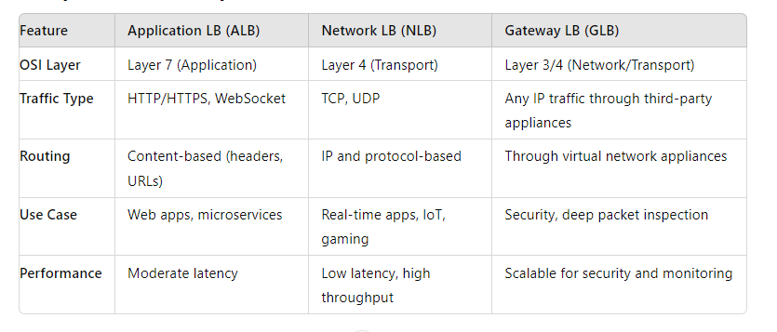
Comparison Table

Slide 10
Key Load Balancing Algorithms
1. Round Robin:
Explanation: Requests are distributed in a cyclic manner across available servers.
Pros: Simple to implement, works well for evenly distributed workloads.
Cons: Does not account for server load or resource availability.
2. Least Connections:
Explanation: Sends traffic to the server with the fewest active connections.
Pros: More dynamic than round robin, adjusts based on real-time server loads.
Cons: May not work well in environments where connection durations vary.

Slide 11
3. Weighted Round Robin:
Explanation: Servers are assigned weights based on their capacity, and traffic is distributed proportionally to these weights.
Pros: Accounts for server capacity differences, better for heterogeneous environments.
Cons: More complex than standard round robin.
4. IP Hashing:
Explanation: Client requests are routed to servers based on a hash of their IP address, ensuring consistent routing for specific clients.
Pros: Ensures consistent server for the same client.
Cons: Does not account for server load or capacity.

Slide 12
Conclusion
Load balancing is critical in distributed computing for managing traffic, ensuring availability, and optimizing performance.
Key algorithms, tools, and strategies help manage modern workloads in both traditional and cloud environments.

